Slide 1
Basic Movement
Mack 2023

Slide 2
Learning Objectives
Students will be able to set up a player controller in a 2D game.
Students will be able to implement a game over state when the player hits obstacles.
Students will understand the concept of velocity input and grounding the player.

Slide 3
The Player
In this lesson, we are going to be setting up our player controller. It will allow us to give it a velocity input that will automatically move our player throughout the world. It will also take into account grounding the player, making sure they won’t fall for any obstacles.

Slide 4
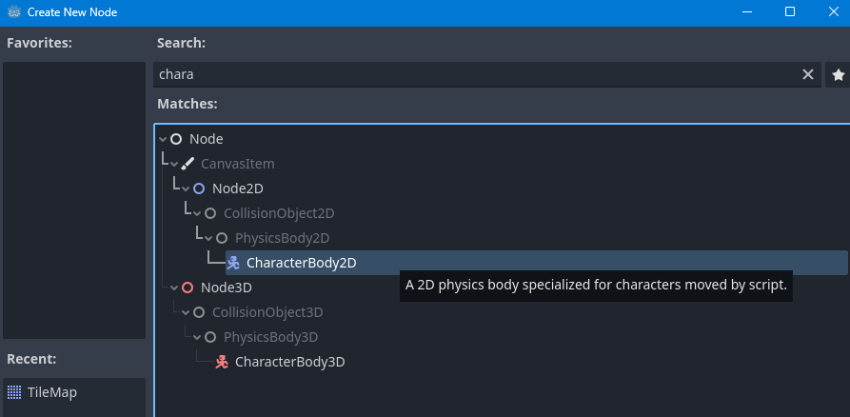
Creating a Node
To begin, we are going to be creating a CharacterBody2D node by clicking the plus button in the Scene tab.

Slide 5
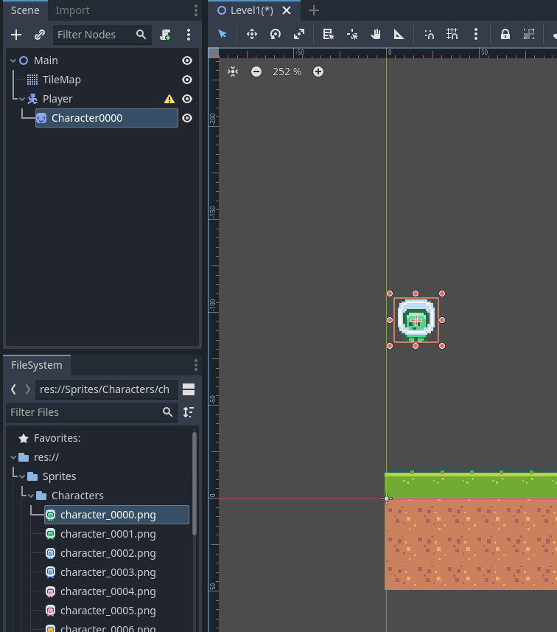
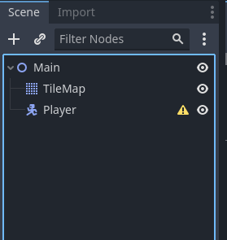
Creating a Node
This can then be named Player.
We need to give our player a Sprite. We can do this by selecting one of our character Sprites and dragging it into the scene to create a Sprite node
Notes:
We then need to make this sprite a child of the Player node (by dragging and dropping the node on top of Player in the Scene view) and rename it to Sprite.

Slide 6
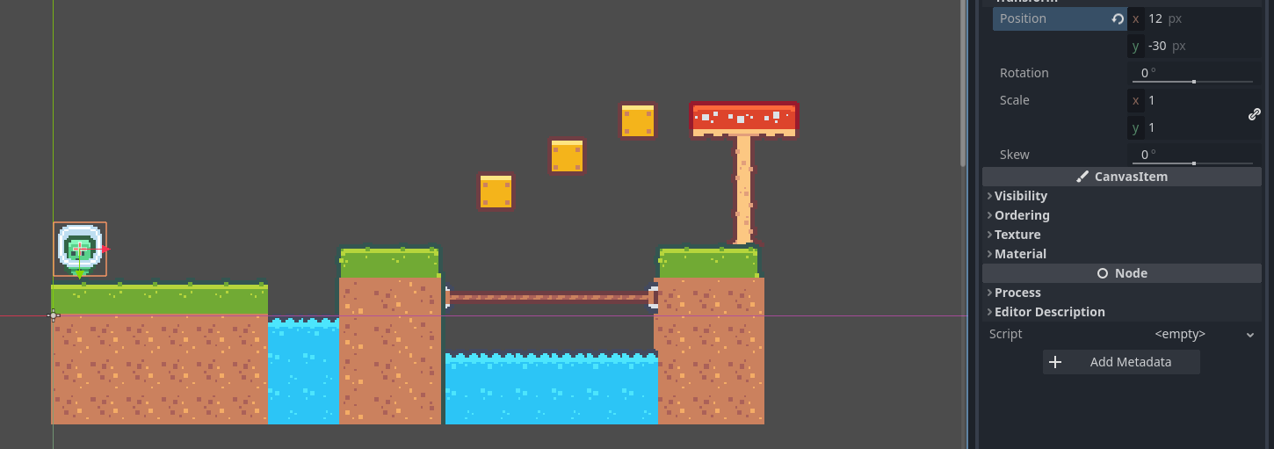
Creating a Node
Then to center the sprite, set the sprite’s Position value to (12, -30) in the Inspector tab. Note: This is the location of my start position! Your’s might be different!
Notes:
We then need to make this sprite a child of the Player node (by dragging and dropping the node on top of Player in the Scene view) and rename it to Sprite.

Slide 7
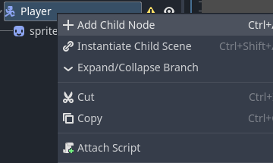
Creating a Node
We then need to add in a collider. To do this, right-click on the Player node in the Scene tab and select Add Child Node.

Slide 8
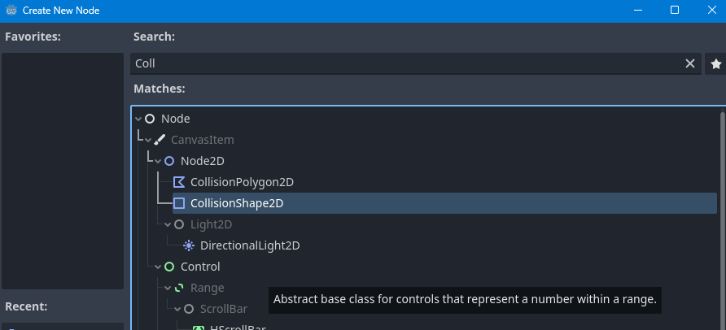
Creating a Node
We will then add a CollisionShape2D node.

Slide 9
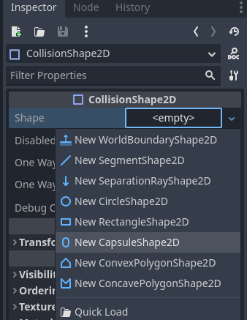
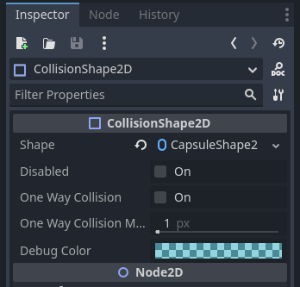
Creating a Node
We can then go to the Shape value in the Inspector and create a capsule.

Slide 10
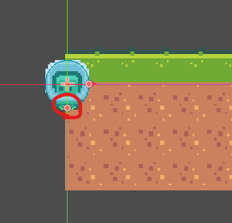
Creating a Node
Then use the orange circles on the new blue capsule in the scene view, to scale the capsule to the size of the Sprite.

Slide 11
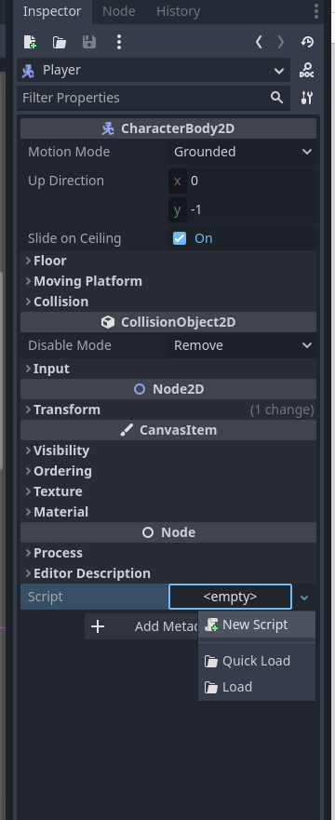
Setting up our first script
We then need to create a script that is going to give our player the ability to move around and jump. To do this, in the Inspector tab, choose Create Script under the Script property.

Slide 12
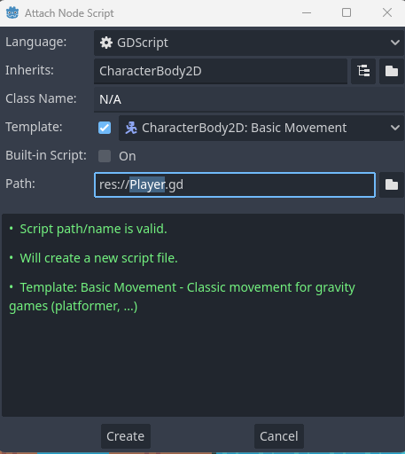
Setting up our first script
The default values should be fine, just ensure the script is called Player.gd and that it inherits from CharacterBody2D. Then press the Create button.

Slide 13

Setting up our first script
There may be some default code in the editor, but for this lesson, we will select all of it (apart from the first line) and delete it. This should leave you with the following code:

Slide 14

Setting up our first script
This line will give us the ability to communicate with our CharacterBody2D node. Firstly, we will need to create some variables. The first will be our move_speed variable with the line:
Notes:
We gave the script a value of 100.0 which means our character will move at 100 pixels per second.

Slide 15
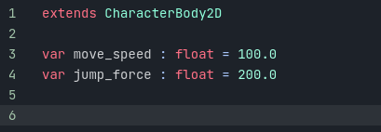
Setting up our first script
For the next line, we will also add a variable called jump_force, which will also be of type float, using the line:
Notes:
This value will be the upwards velocity we add when the user presses the jump button.

Slide 16
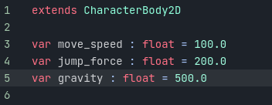
Setting up our first script
We will also create another variable called gravity, with the type of float, using the line:
Notes:
This value will be the downward force we use as our gravity, to combat the jump_force value.

Slide 17
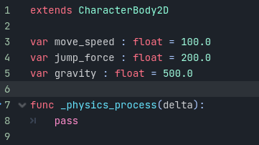
Physics Process Function
We are going to create a function called _physics_process. The physics process function is generally where you want to run the physics code that you want to check every frame. This function gets run at a consistent rate per second. To do this we will add the function to our code:

Slide 18
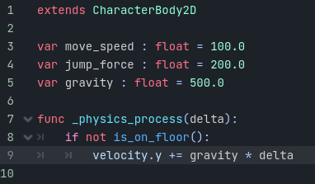
Physics Process Function
In this function, we are going to be applying gravity. To do that, we first want to check to see if the Player is not standing on the floor by using the is_on_floor function. Then, if we are not standing on the floor, we want to modify our vertical velocity by our gravity value.
Notes:
Multiplying by the delta value above will convert a per-frame action, into a per-section action.

Slide 19
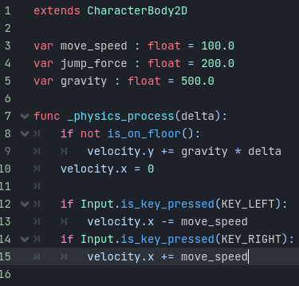
Physics Process Function
We then want to have the ability to move left and right. We will being by setting our X velocity to zero, and if we are pressing the left key, we want to set our velocity to be negative move speed. If we are pressing the right key, we then want to set our velocity to be positive move speed. This can be done using the following code:

Slide 20
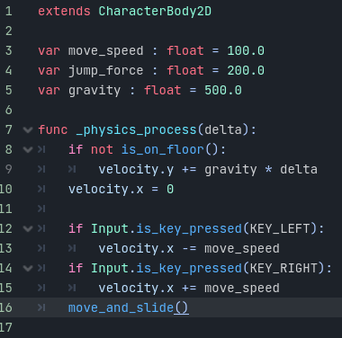
Physics Process Function
Finally, we need to apply the velocity to the CharacterBody2D node so that Godot can process our movement. This will be done using the move_and_slide function that will move our player based on the velocity and slide across objects like ramps.

Slide 21

Testing the Movement
We can then save this script (CTRL + S) and return back to our 2D scene view.

Slide 22
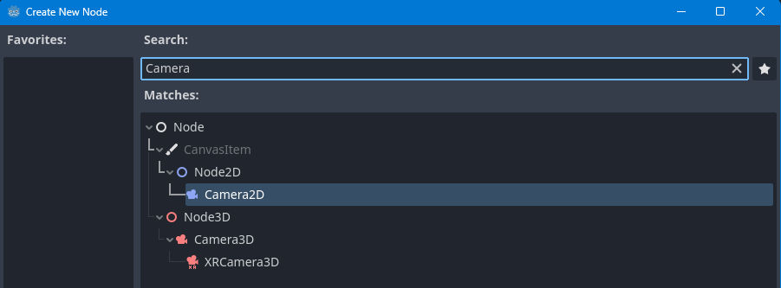
Testing the Movement
If you test the game you will notice we can’t see anything, this is due to our camera isn’t showing what we want to render. To fix this, we are going to add a new node of Camera2D.

Slide 23
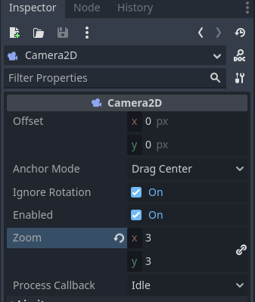
Testing the Movement
We can then zoom in a bit by changing the zoom property to (3, 3).

Slide 24
Testing the Movement
Now, we can press the Play button, and we should be able to see our character. If you get a pop-up when pressing play, choose the Select Current option.
When you test the game you will notice our player falls through the ground. Don’t worry, this is an easy fix.

Slide 25
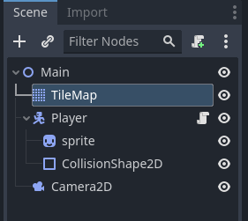
Adding Ground Collisions.
Firstly, we want to select our TileMap node in the Scene tab.

Slide 26
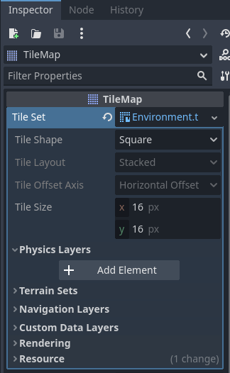
Adding Ground Collisions.
We then want to open the Physics Layers tab in the Inspector and press Add Element.

Slide 27
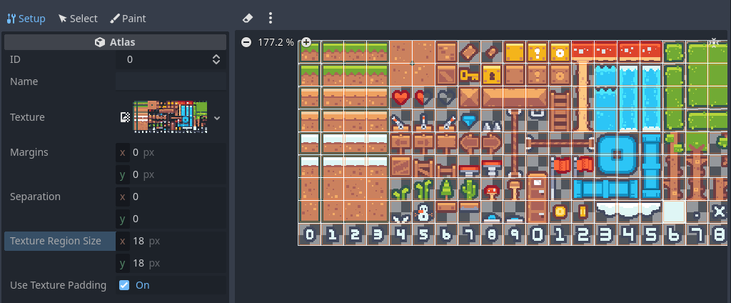
Adding Ground Collisions.
We then need to add this physics layer to our tiles. In the Tileset tab, select the Paint option.

Slide 28
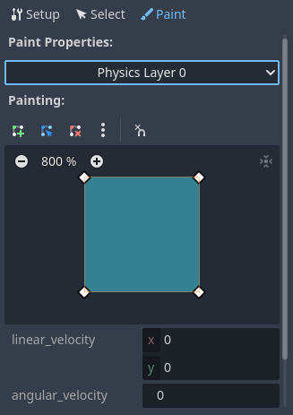
Adding Ground Collisions.
Then choose the Physics Layer 0 option in the Select a property editor option.

Slide 29
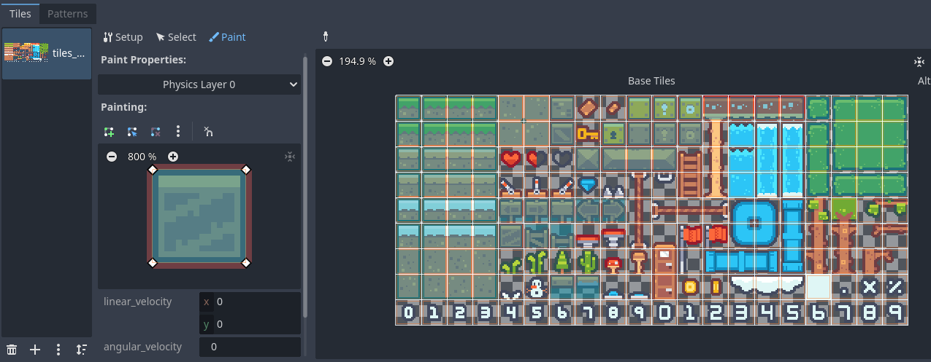
Adding Ground Collisions.
Then we can go through and “paint” all of the tiles that we want to have collisions with, using the left mouse button.

Slide 30
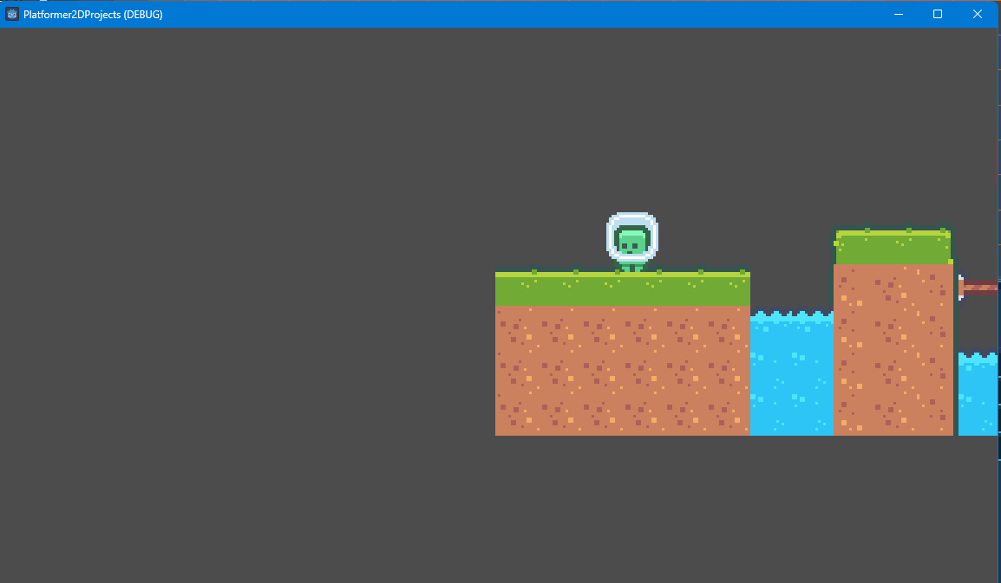
Testing the Game
Now when you press Play you should be able to move left and right using the keys we set up earlier, and gravity will affect the Player if it falls off the edge of the terrain we made.

Slide 31
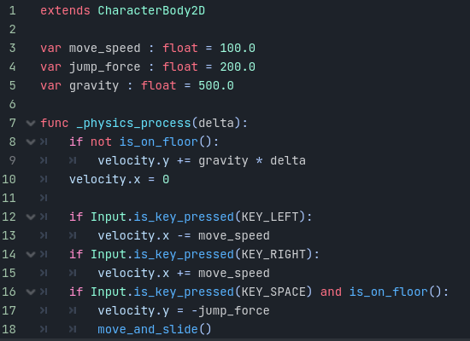
Adding Jumping to our Player Script
As well as moving and falling, another important section of a platformer game is jumping. To do this, we will reopen our Player script and add the following lines above the move_and_slide function call.

Slide 32
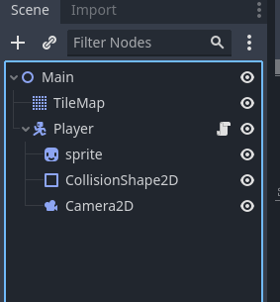
Adding Jumping to our Player Script
This will add our jump force to the player (negative to say going upward) if the player presses the spacebar and is on the ground. We also want our Camera to follow the Player, to do this, just drag and drop the Camera node as a child of the Player node.

Slide 33
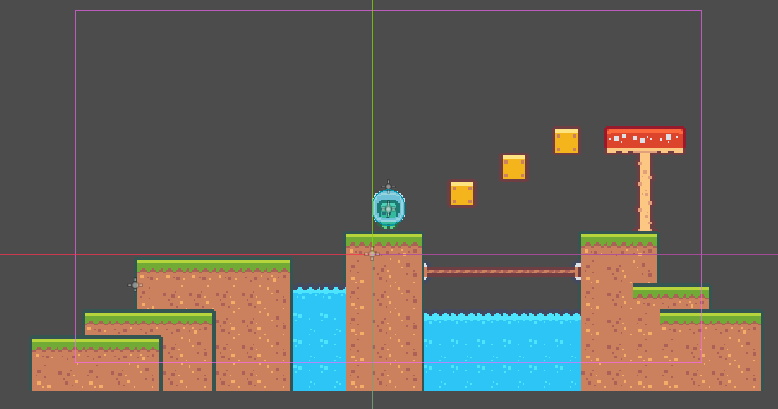
Adding Jumping to our Player Script
You can also position the Camera to be just above the Player Sprite using the arrow tools in the editor window.

Slide 34
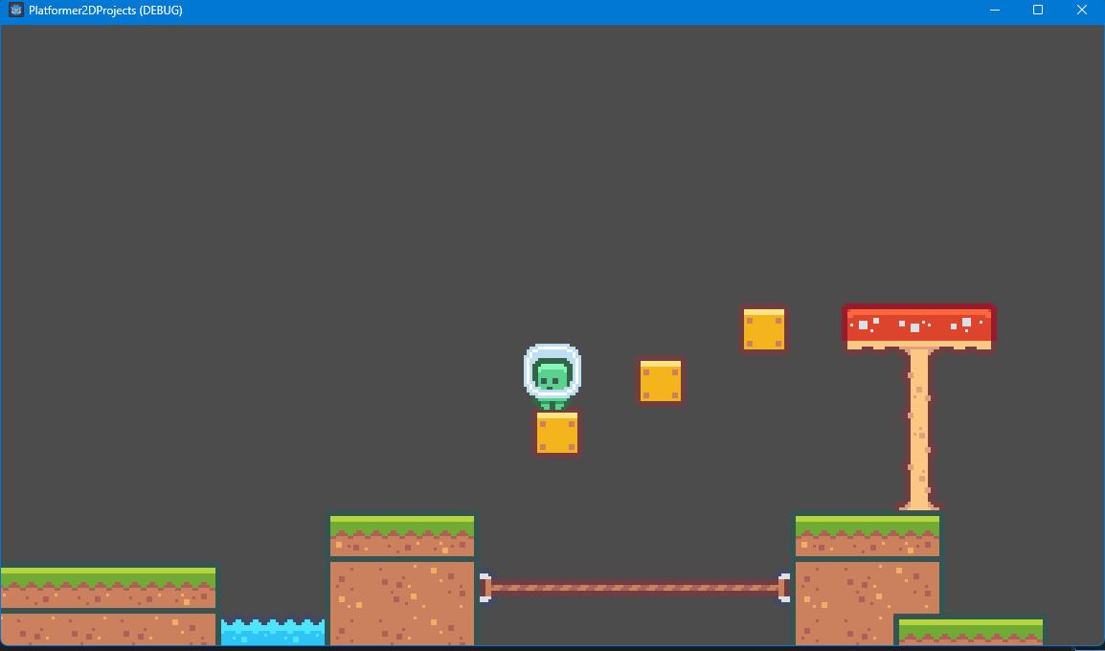
Adding Jumping to our Player Script
Now, you can press space to jump around your level, use the arrow keys to move left and right, and you will fall due to gravity, all from this one simple Player script.

